Slide 1




Mental Health Center
Own Your Word
By Initiative Gang Team

Slide 2
ABOUT US
our name came from the greek god who was related to the mind and the well- being
and thats we will work on here in elysiium and thats why we are here that we will be concentrating on the mental health, well-being and how to develop and improve your life in general.
elysiium is a place where you feel like home and safe, its a place to transform your life in a very healthy way as we do have the expertise in well-being from Greek.
we studied greek way of thinking, healing and the way how transform their lives to be better and thats
why we are here!

Slide 3
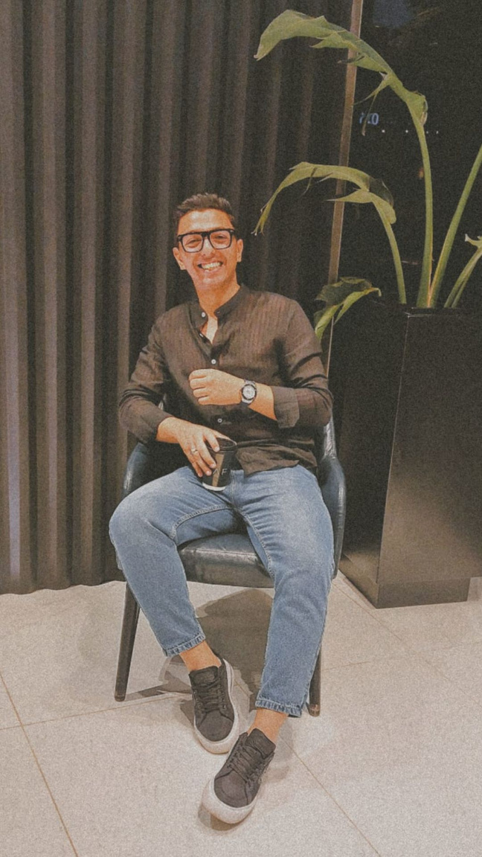
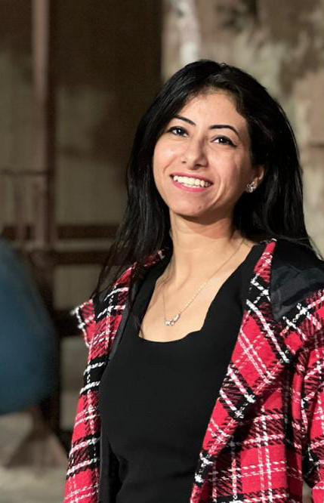
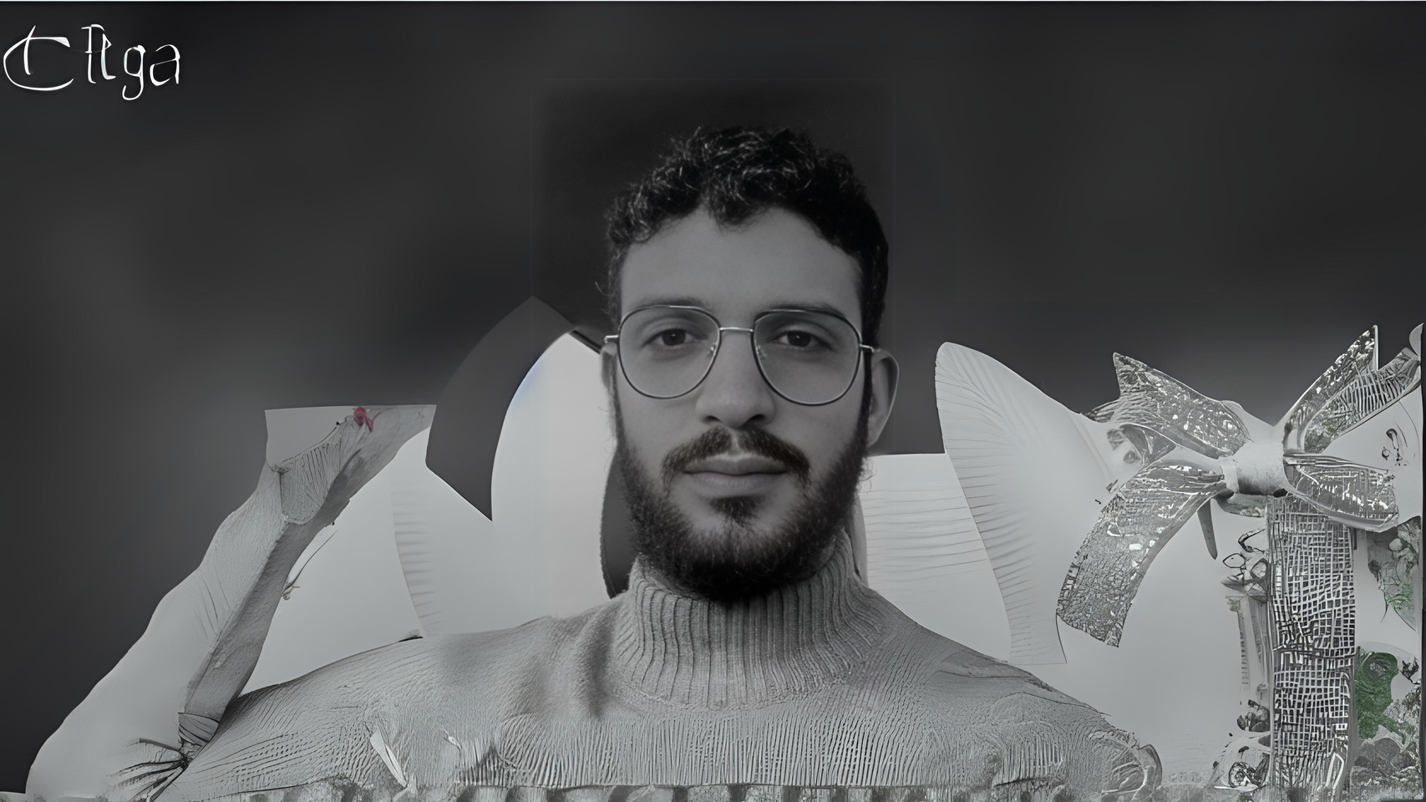
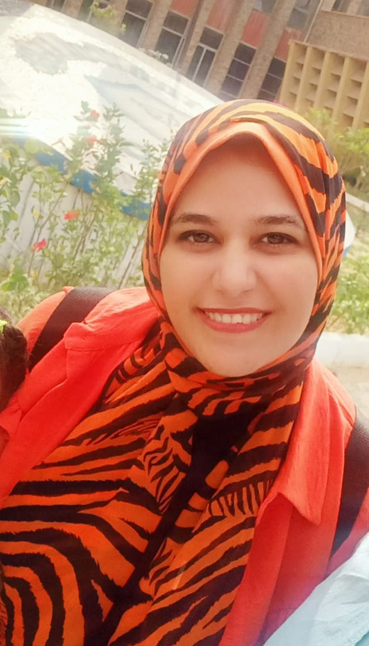
OUR TEAM
Mohamed
Marwa
Zeyad
Sara

Slide 4
OUR BUSINESS MODEL
Schools
Universities
Clubs
Beaches (New Alamein)
Government Initiatives
Relevant Events
Corporates
Therapy (CBT, DBT, Art, sound )
Coaching
Workshops and Events
Group Therapy
Guiding, Healing and Transforming.
Elysium is a centre which would be concentrates on the customer and their experience from hearing, guiding them and trying to heal or overcome their traumas and how to transforming their life for the better or the one they wanted.
Personalized Client Experience
Memberships
reminder and follow up reminder, quotes from app
offers in events and free sessions
Employee And Freelancers
(High-Stress Job)
Young Adults &University Students
Families & Parents
Individuals Seeking Holistic Wellness
Male And Famale
Cairo And Alexandria
From 18 To 45
Key Partners
Key Activities
Value Propositions
Customer Relationship
Customer Segments
website
Location
App
3 instructors
3 Therapist & 1 doctor
3 admins
Key Resources
social media
websites & app
booths
flyers awareness
Channels
Doctors & Team
Marketing & Operations
Location & Online Purchase
app download And Ads
memberships And Subscriptions
Sponsorships
Collaboration with Corporate and startup
Cost Structure
Competitors
Revenue Stream
O7 Therapy
Arab therapy
Shezlong
BetterHelp
Notes:
add compatoriors

Slide 5
Swot Analysis
STRENGTHS
WEAKNESS
Diverse Services
Brand Name and Culture
Collaboration
Staff
Service Innovation
High Operating Cost
High Reliance on Partnership
Team Training
OPPURTINITES
THREATS
Increase Awareness About Mental Health
Strategic Partnership
High-Stress
High Competition
Economic Changes
Legislative Challenges
Stigma Associated With Mental Health

Slide 6

OBJECTIVE
Increase subscriptions 100 client within the first 6 months, focusing on annual membership plans.
Partner with 5 universities 7 Schools and 10 companies to offer quarterly mental health workshops.
Reach 500 active annual Digital subscribers by the end of the first year, supported by consistent social media engagement and quarterly promotional offers.
Build a follower base of 10,000 on social media by the end of the year to boost brand awareness and community engagement(Instagram, YouTube, Snapchat,LinkedIn)
Achieve a 90% client satisfaction rate by consistently delivering high-quality, personalized services by End of the year 24

Slide 7
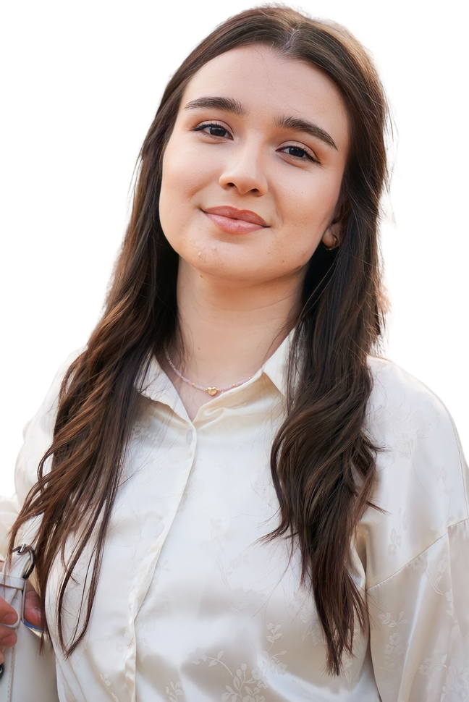
BAYER PERSONA
Pain or problems:
Her schedule is busy with work and personal life, so she is looking for efficient and fast services
Mariam
Objectives:
She seeks to maintain her natural beauty, and cares about skin care.
Looking for relaxation and energy renewal.
Seeks to experience high-quality services in the field of personal care
Married
35
years old
Office manager
Work pressure
Future anxiety
What you need from Elysium Center:
Distinctive massage and relaxation sessions.
Motivations:
You need centers that provide a luxurious experience and feel rejuvenating.
Prefer exclusive offers and personal attention.
Values ​​innovation in products and services.
Tone of communication with her:
Friendly, youthful, and interactive.
It is preferable to focus on luxury, comfort and high quality.
Use photos and videos in communication to highlight the service experience
Hobbies and interests:
Interested in health and personal care.
Follow fashion and beauty updates.

Slide 8
STRATEGY
Positioning
Our mental health center in NewCairo is dedicated to providing compassionate, high-quality mental health services tailored to meet the diverse needs of our community in Cairo using the best techniques applied in the best mental health centers in Greece. We offer a safe, inclusive, and supportive environment where individuals and families can find the care and resources they need to thrive. We offer experts from Greece on regular basis.

Slide 9

VALUE PROPOSITION
1- We provide customized programs and individual services for each case
2- We integrate modern techniques with art therapy, music therapy, and cognitive behavioral therapy
3- Mobile App: Daily exercises and advice are provided to it, and there is an evaluation for the client’s follow-up of himself and the therapist’s follow-up with him first
4- Creating a supportive community with success stories of recovering people
5- Follow up with the client after the treatment period: for prevention and well-being
6- Focus on privacy and confidentiality
7- Workshops and seminars for the client’s family and friends to prepare the environment surrounding him to help him in psychological development
8- Cooperating with local institutions and focusing on participatingin the President ofthe Republic’s initiative ( Bdaia Gadida ) to build people, which aimsto invest in human capital.

Slide 10
7 P
S
The 7 Ps are 7 matrices which include “Product, Place, price, Promotions, People, Process, Physical Evidence “which are essential for effective marketing, showcasing services, ensuring customer satisfaction, and building a strong relationship with clients and other business

Slide 11
7 P
S
Product
Places
Price
People
Process
Mental Health for therapy, coaching, education, and other activities for mindfulness through different kinds of events and workshops. Also with variety of membership
Duplex apartment with garden or a villa in 5th settlement.
With a garden and simple decoration, it would be relaxing for the eyes with fresh air.
Online website and page whcih would include soem information about the center and the plans for memeberships
When it comes to the price, we do have differences if the client would need one session or multiple sessions or membership.
1 session for 1k and he can apply for financial aid and will get 40% off
Multiple sessions like 6 a month which is 2 a week will be 4.5 k.
If the customer through another customer both will get 10 % off
Well-educated doctors and therapists with experience so they can deal with all client's issues effectively.
Training all the staff and educating them on how they will treat our clients guide them correctly and be nice to them so they will feel that they are engaged with Elysium
Our focus will be on the customer experience and how they feel while they are at Elysuim, they should feel as if they are at home with the most professional treatment and premium experience through management and experienced customer service
Easy access and understanding of online experience
Also concentrating customer loyalty by sending follow-up msg and checking up on them
Physical Evidence
Our visuals will be consistent with green and beige which are the colours which represent the brand, our centre and also represent peacefulness.
The website will be easy to deal with logo colours and easy to schedule an appointment, and also there will be a review section as we care about the customers' opinion to develop our centre.

Slide 12
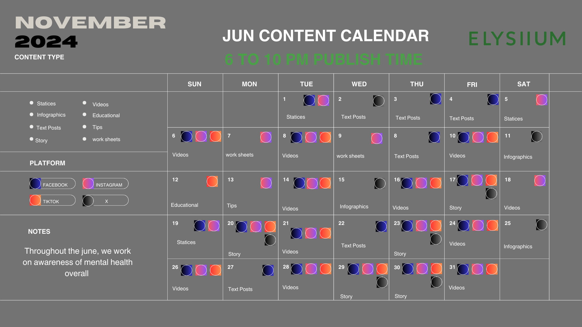
CONTENT CALANDAR

Slide 13
ACTION PLAN
1. Objectives
4. Timeline
2.Tasks or Activities
5. Resources Required
3. Responsibilities
6.KPIs
7- Risks & Challenges

Slide 14
KEY WORDS
Mental health & psychological support
Emotional support
Psychological fatigue
Yoga
Depression
Suicide
Adolescence
Meditation
Misunderstanding
Anxiety
Stress control
Boredom
Lack of self-confidence
Autism
Addiction
Mind full of though
Difficulty in learning
Social phobia
Bipolar disorder
Post-traumatic stress disorder “ PTSD “
Neurodivergent
Eating disorder

Slide 15
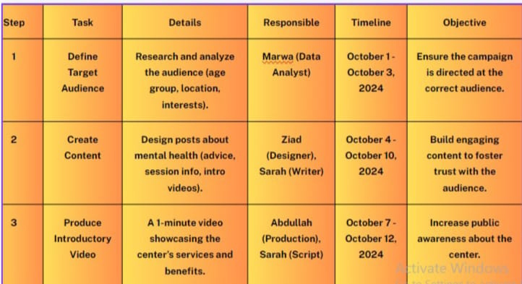
Action plan

Slide 16
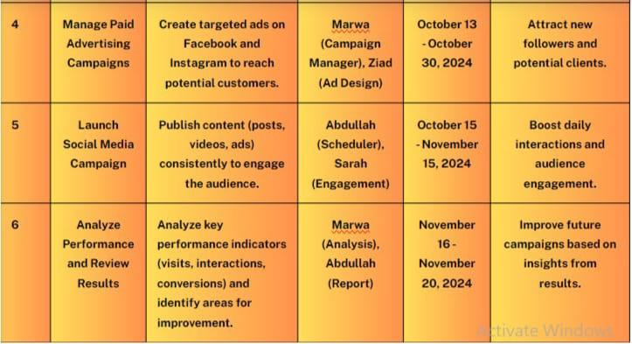

Slide 17
Content and Media Buying

Slide 18
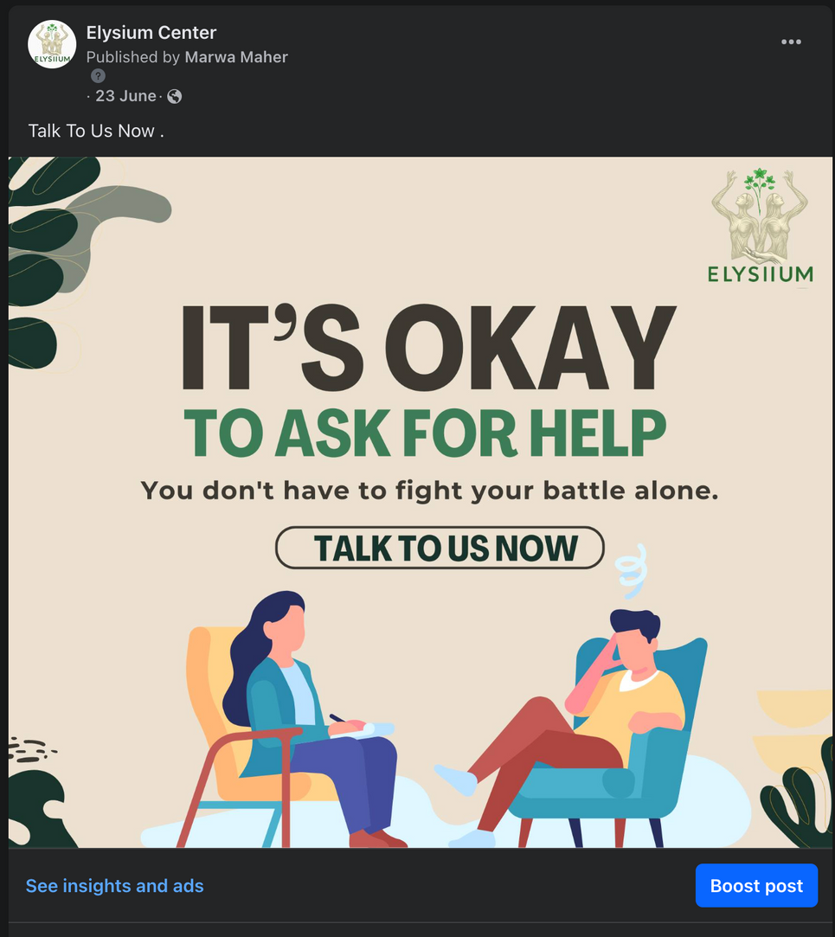
Example
Piece of Content
Visual
Caption
Talk To Us Now.

Slide 19
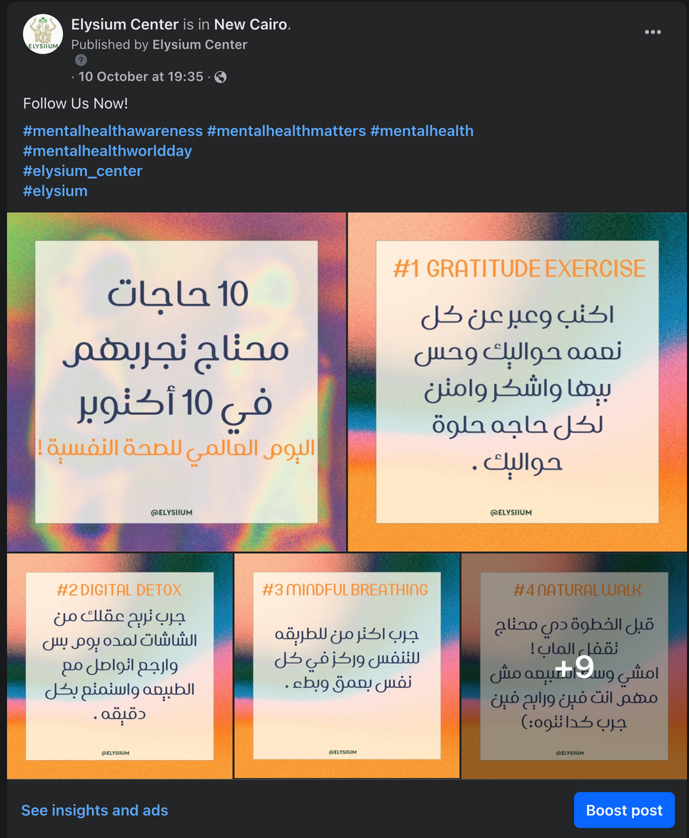
Example
Piece of Content
Carousel
Caption
Follow Us Now!
#mentalhealthawareness #mentalhealthmatters #mentalhealth
#mentalhealthworldday
#elysium_center
#elysium

Slide 20
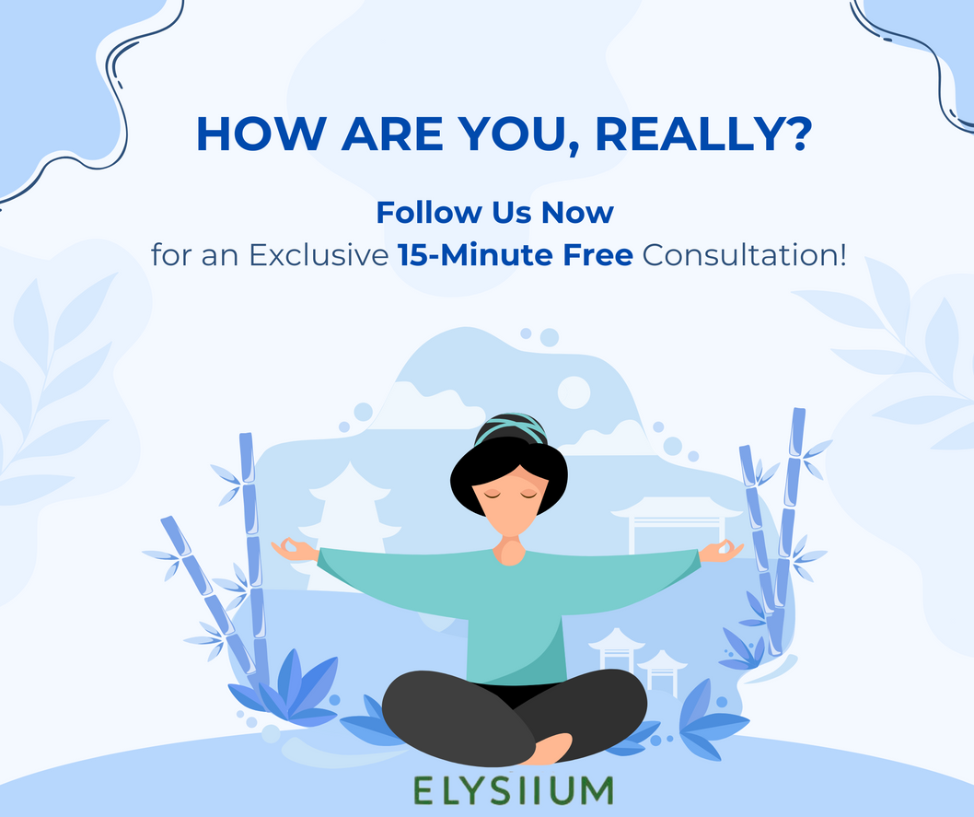
Example
Piece of Content
Visual
Caption
Ready to unlock secrets of success?
Follow us now on elysiium center page
and enjoy 15 free Minutes that could change your life!

Slide 21
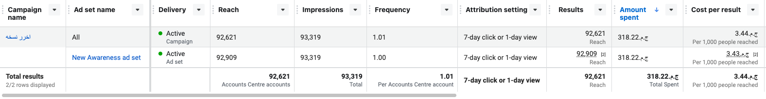
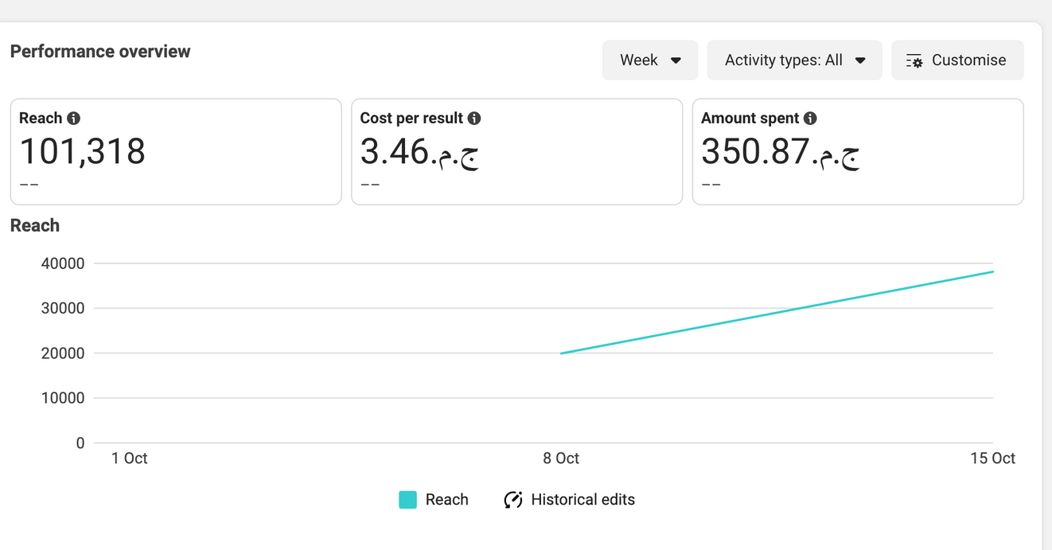
Results Campaign

Slide 22
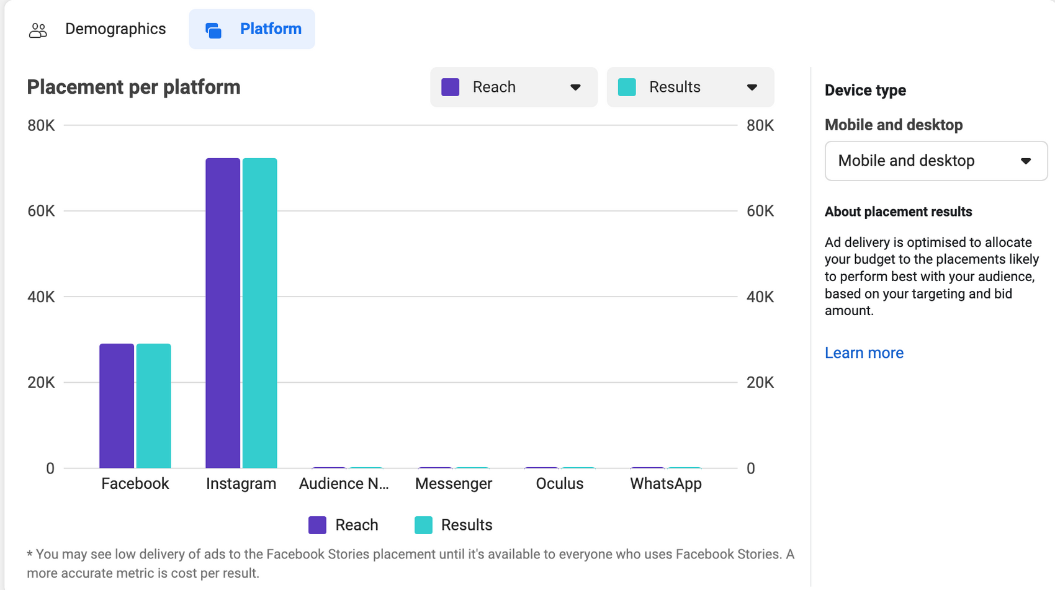
Results Campaign

Slide 23
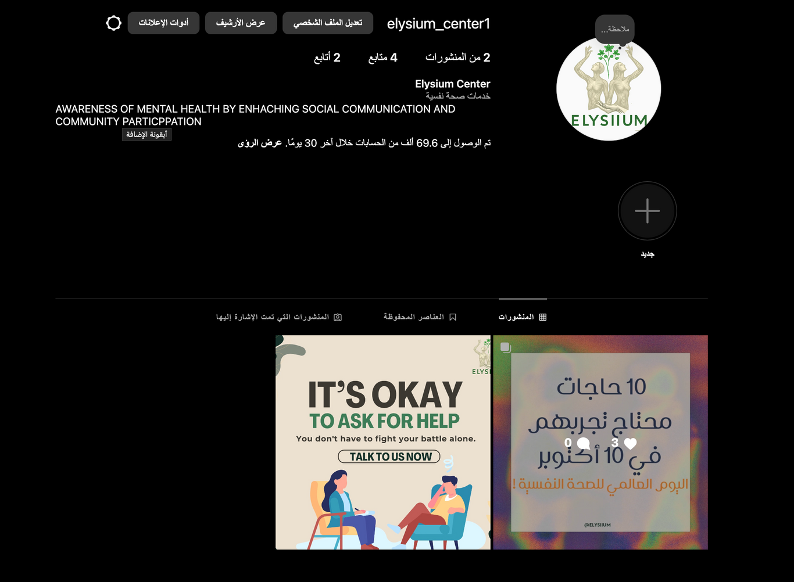
our social media .

Slide 24
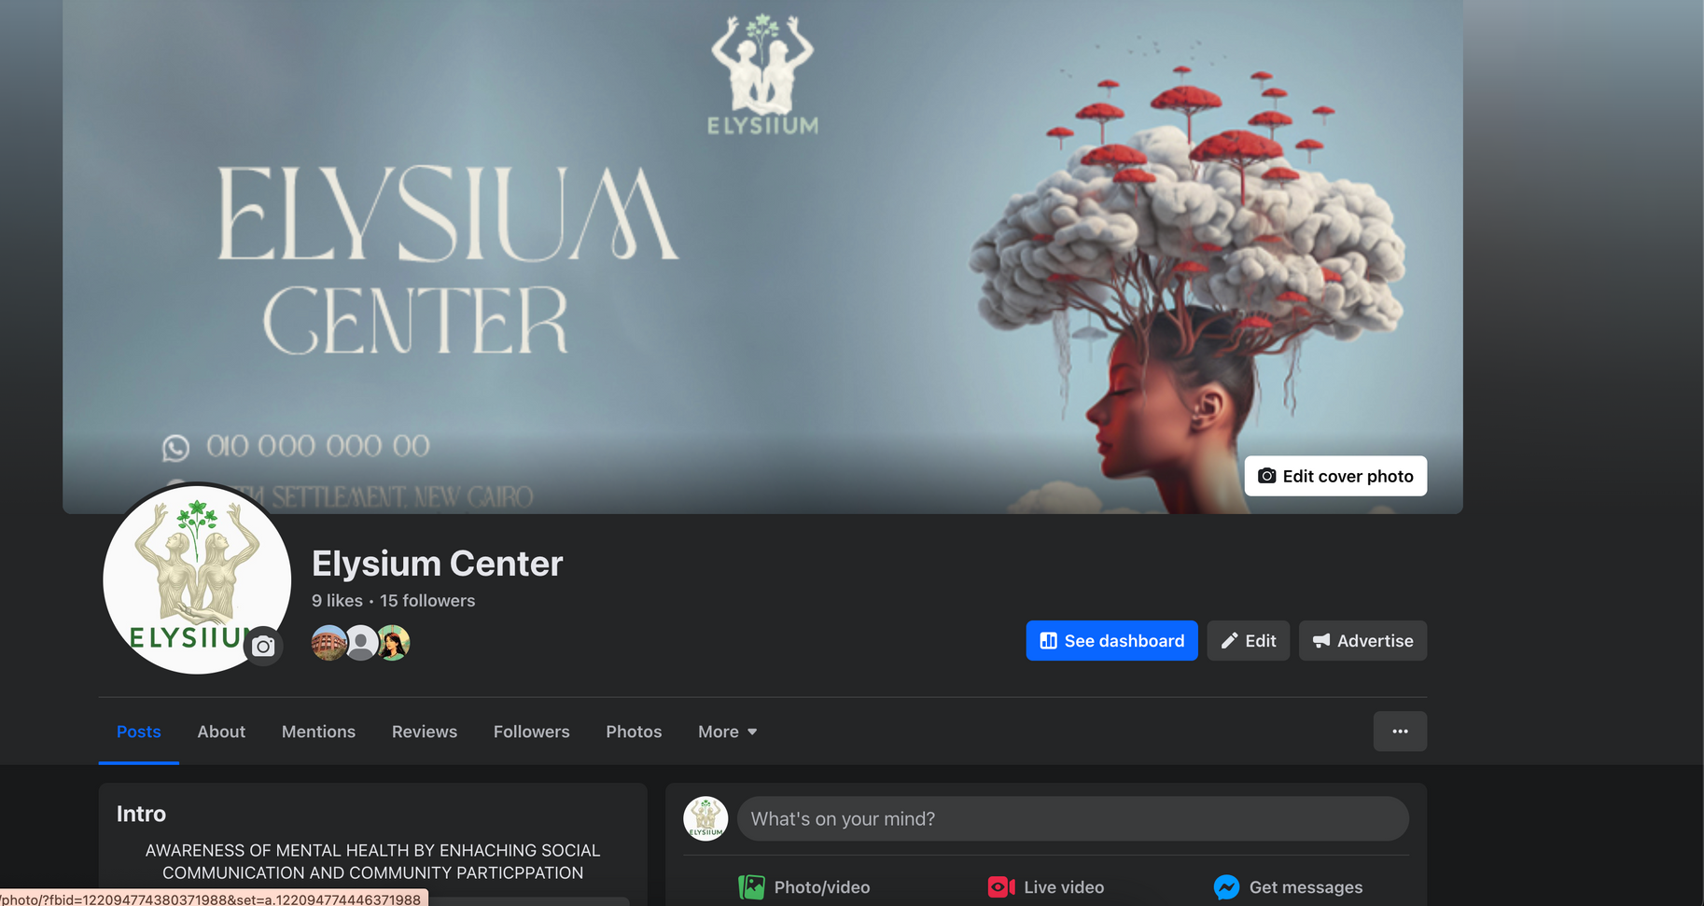
our social media .

Slide 25
6.CONTROL
Identify measurement tools: Use tools like spreadsheets or project management software (such as Trello, Asana or Monday.com) to track task progress. Dedicate a column to the weekly KPIs for each team or task.
To know the number of followers - the extent of interaction with publications - the number of customers who responded and actually participated in the center’s sessions

Slide 26
KPIS
BRAND AWARENESS KPIS:
Reach ratio:
In July, 50,000 people were reached via social media platforms (Facebook, Instagram).
Number of impressions:
The total number of impressions was 120,000 across various channels during the same period, which means the audience saw the content multiple times.
Follower Growth:
At the end of July, 2,000 new followers were added on Instagram, indicating an increase in brand awareness.

Slide 27
KPIS
ENGAGEMENT KPIS
Engagement rate:
The engagement rate was 5%, measuring 6,000 interactions (likes, comments, shares) out of a total of 120,000 impressions.
Number of comments and shares:
During the month, 400 comments and 200 shares were recorded on the posts, indicating strong engagement with the content.
Video viewing duration:
5 videos were published about mental health, and the average viewing duration for each video was 30 seconds out of a 1-minute video, which reflects a good viewership rate.

Slide 28
KPIS
KPIS FOR TRUST AND BUILDING RELATIONSHIPS
Number of direct messages:
The center's account received 150 private messages inquiring about treatment sessions and available services, which reflects interest from the public in interacting with the center.
Conversion Rate:
Out of 150 messages, 30 people booked an actual counseling session, which means a conversion rate of 20%.

Slide 29
KPIS
SALES & CONVERSIONS KPIS:
Number of Bookings:
During the month, 60 bookings were recorded for counseling sessions, most of which were the result of social media advertising campaigns.
Total Revenue:
The revenues generated from these sessions amounted to 30,000 Egyptian pounds, with an average of 500 pounds per session.

Slide 30
KPIS
TRUST & CREDIBILITY KPIS:
Customer Reviews:
The center received 50 reviews via Google and Facebook, with an average rating of 4.8 out of 5, reflecting customer satisfaction with the service.
Customer Retention Rate:
Of the 60 clients who booked a session, 15 clients returned to book additional sessions, indicating a client retention rate of 25%.

Slide 31
RECOMMENDATIONS TO IMPROVE
Enhance Digital Skills:
Implement training workshops focused on digital skills, such as digital marketing, content management, and data analysis.
More engagement reels the customer
Digitize Internal Processes:
Digitize daily operations to streamline work and boost productivity by using digital project management tools like Trello or Asana.
Provide easy access to data and information through shared platforms like Google Workspace or Microsoft 365.

Slide 32
RECOMMENDATIONS TO IMPROVE
Foster Digital Innovation:
Create internal platforms where employees can present new digital ideas and encourage innovation.
Motivate employees to leverage technological tools to improve daily tasks and enhance operational efficiency.
Ehance Internal Communication:
Use instant communication apps like Slack or Microsoft Teams to facilitate team collaboration and increase efficiency.
Hold regular virtual meetings to save time and improve effective communication.

Slide 33

DISCUSSION

Slide 34

Powered by: Dr. Tamer

